Slide 1
Cornerstone City Church Peninsula Plus Community Hoo Are Ya
21st July 2024

Slide 2
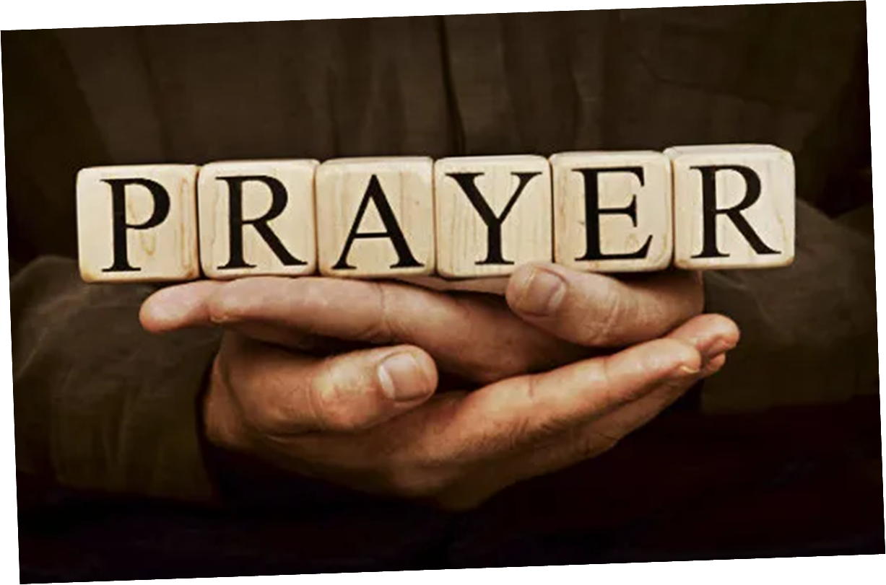

Slide 3


Slide 4
Sacrifice of Praise
Olumide Iyun

Slide 5
1/4
We bring to you the sacrifice of praise
Give thanks to you with all our voices raised
For you are good
For your mercy never fails

Slide 6
2/4
We celebrate before the throne of grace
For you are great and greatly to be praised
For you are good
For your mercy never fails

Slide 7
3/4
You are good
You are good
You are good
For your mercy never fails
(REPEAT)

Slide 8
4/4
For you are good
For your mercy never fails
(X3)

Slide 9
Our God
CCLI Song # 5677416
Chris Tomlin | Jesse Reeves | Jonas Myrin | Matt Redman
© 2010 sixsteps Music (Admin. by Integrity Music)
Thankyou Music (Admin. by Integrity Music)
Vamos Publishing (Admin. by Integrity Music)
worshiptogether.com songs (Admin. by Integrity Music)
Atlas Mountain Songs (Admin. by SHOUT! Music Publishing UK)
For use solely with the SongSelect® Terms of Use. All rights reserved. www.ccli.com
CCLI Licence No. 33265

Slide 10
1/3
Water You turned into wine Opened the eyes of the blind There's no one like you None like you Into the darkness You shine Out of the ashes we rise There's No one like you None like you

Slide 11
2/3
Our God is greater,
Our God is stronger God You are higher than any other Our God is Healer,
Awesome in power Our God, Our God

Slide 12
3/3
And if Our God is for us,
Then who could ever stop us? And if our God is with us,
Then what can stand against?
(REPEAT)

Slide 13
This is Our God
CCLI Song # 7211413
Brandon Lake | Pat Barrett | Phil Wickham | Steven Furtick
© Brandon Lake Music; Phil Wickham Music; Simply Global Songs; Capitol CMG Genesis; Housefires Sounds; Music by Elevation Worship Publishing
For use solely with the SongSelect® Terms of Use. All rights reserved. www.ccli.com
CCLI Licence No. 33265

Slide 14
1/9
Remember those walls that we called sin and shame
They were like prisons that we couldn’t escape
But He came and He died and He rose
Those walls are rubble now

Slide 15
2/9
Remember those giants we called death and grave
They were like mountains that stood in our way
But He came and He died and He rose
Those giants are dead now

Slide 16
3/9
This is our God this is who He is
He loves us
This is our God this is what He does
He saves us
He bore the cross beat the grave
Let heaven and earth proclaim
This is our God King Jesus

Slide 17
4/9
Remember that fear that took our breath away
Faith so weak that we could barely pray
But He heard every word every whisper
Now those altars in the wilderness
Tell the story of His faithfulness
Never once did He fail and He never will

Slide 18
5/9
This is our God this is who He is
He loves us
This is our God this is what He does
He saves us
He bore the cross beat the grave
Let heaven and earth proclaim
This is our God King Jesus

Slide 19
6/9
Who pulled me out of that pit
He did He did
Who paid for all of our sin
Nobody but Jesus

Slide 20
7/9
Who rescued me from that grave
Yahweh Yahweh
Who gets the glory and praise
Nobody but Jesus (Him)

Slide 21
8/9
This is our God this is who He is
He loves us
This is our God this is what He does
He saves us
He bore the cross beat the grave
Let heaven and earth proclaim
This is our God King Jesus

Slide 22
9/9
He bore the cross beat the grave
Let heaven and earth proclaim
This is our God King Jesus

Slide 24
Oceans (Where Feet May Fail)
G.CcliSongNumber 6428767
Joel Houston | Matt Crocker | Salomon Ligthelm
© 2012 Hillsong Music Publishing Australia
For use solely with the SongSelect® G.LIT_TermsOfUse. All rights reserved. www.ccli.com
G.CcliLicenseNumber 33265

Slide 25
1/6
You call me out upon the waters
The great unknown where feet may fail
And there I find You in the mystery
In oceans deep my faith will stand

Slide 26
2/6
And I will call upon Your name
And keep my eyes above the waves
When oceans rise
My soul will rest in Your embrace
For I am Yours and You are mine

Slide 27
3/6
Your grace abounds in deepest waters
Your sov'reign hand will be my guide
Where feet may fail and fear surrounds me
You've never failed and You won't start now

Slide 28
4/6
And I will call upon Your name
And keep my eyes above the waves
When oceans rise
My soul will rest in Your embrace
For I am Yours and You are mine

Slide 29
5/6
Spirit, lead me where my trust is without borders
Let me walk upon the waters
Wherever You would call me
Take me deeper than my feet could ever wander
And my faith will be made stronger
In the presence of my Saviour

Slide 30
6/6
And I will call upon Your name
And keep my eyes above the waves
When oceans rise
My soul will rest in Your embrace
For I am Yours and You are mine

Slide 31
Still
CCLI Song # 3940963
Reuben Morgan
© 2002 Hillsong Music Publishing Australia (Admin. by Hillsong Music Publishing UK)
For use solely with the SongSelect® Terms of Use. All rights reserved. www.ccli.com
CCLI Licence No. 33265

Slide 32
1/3
Hide me now
Under Your wings
Cover me
Within Your mighty hand

Slide 33
2/3
When the oceans rise
And thunders roar
I will soar with You
Above the storm
Father You are King
Over the flood
I will be still and know
You are God

Slide 34
3/3
Find rest my soul
In Christ alone
Know His power
In quietness and trust

Slide 35


Slide 36
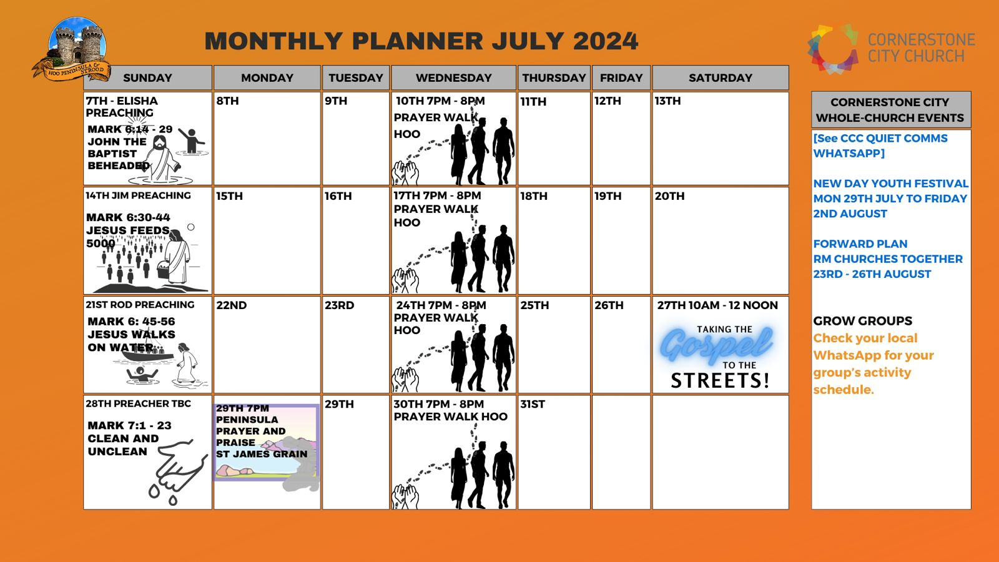

Slide 37


Slide 38


Slide 39
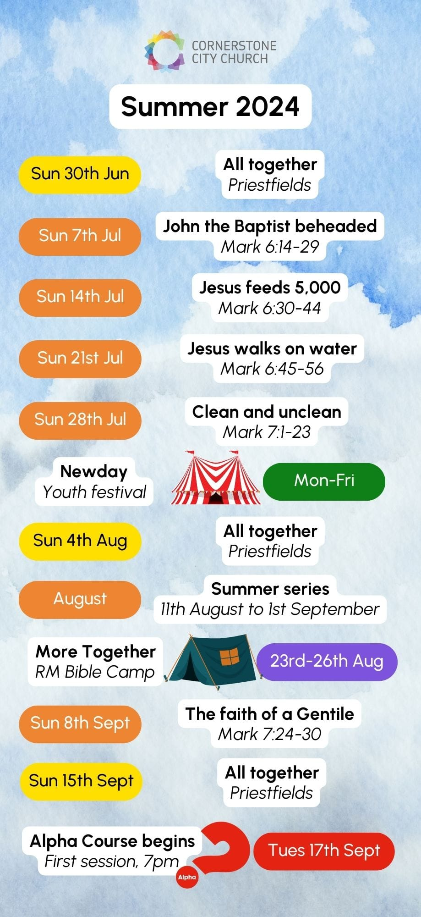

Slide 40


Slide 41
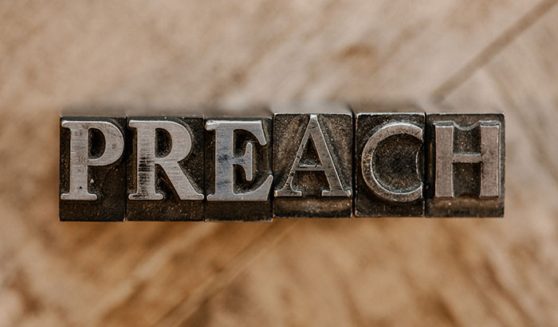

Slide 42
Million Little Miracles
CCLI Song # 7171580
Brandon Lake | Chris Brown | Steven Furtick
© 2021 Music by Elevation Worship Publishing (Admin. by Essential Music Publishing LLC)
Bethel Music Publishing (Admin. by Song Solutions)
Brandon Lake Music (Admin. by Song Solutions)
Maverick City Publishing Worldwide (Admin. by Song Solutions)
For use solely with the SongSelect® Terms of Use. All rights reserved. www.ccli.com
CCLI Licence No. 33265

Slide 43
1/7
All my life I've been carried by grace
Don't ask me how 'cause I can't explain
It's nothing short of a miracle I'm here
I've got some blessings that I don't deserve
I've got some scars but that's how you learn
It's nothing short of a miracle I'm here

Slide 44
2/7
I think it over and it doesn't add up
I know it comes from above

Slide 45
3/7
(I've got) miracles on miracles
A million little miracles
Miracles on miracles
Count your miracles
1-2-3-4 I can't even count 'em all

Slide 46
4/7
You held me steady so I wouldn't give up
You opened doors that nobody could shut
I hope I never get over what You've done
I wanna live with an open heart
I wanna live like I know who You are
I hope I never get over what You've done

Slide 47
5/7
It's not coincidence and it's not luck
I know it comes from above

Slide 48
6/7
(I've got) miracles on miracles
A million little miracles
Miracles on miracles
Count your miracles
1-2-3-4 I can't even count 'em all

Slide 49
7/7
I can't even I can't even count 'em all
I can't even I can't even count 'em all
I can't even I can't even count 'em all 1-2-3-4 I can't even count 'em all

Slide 50
2 Corinthians 14 May the grace of the Lord Jesus Christ, and the love of God, and the fellowship of the Holy Spirit be with you all

